Slide 1
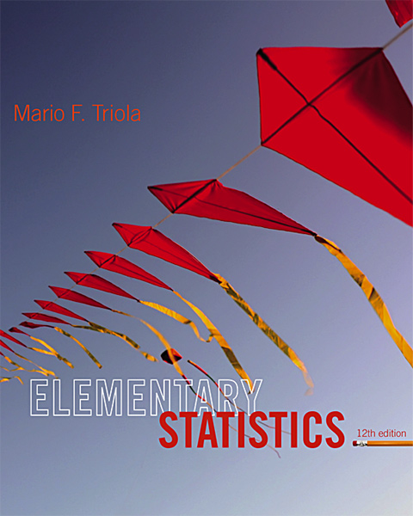
Lecture Slides
Elementary Statistics
Twelfth Edition
and the Triola Statistics Series
by Mario F. Triola

Slide 2
Chapter 6
Normal Probability Distributions
6-1 Review and Preview
6-2 The Standard Normal Distribution
6-3 Applications of Normal Distributions
6-4 Sampling Distributions and Estimators
6-5 The Central Limit Theorem
6-6 Assessing Normality
6-7 Normal as Approximation to Binomial

Slide 3
Key Concept
This section presents methods for working with normal distributions that are not standard. That is, the mean is not 0 or the standard deviation is not 1, or both.
The key concept is that we can use a simple conversion that allows us to standardize any normal distribution so that the same methods of the previous section can be used.

Slide 4
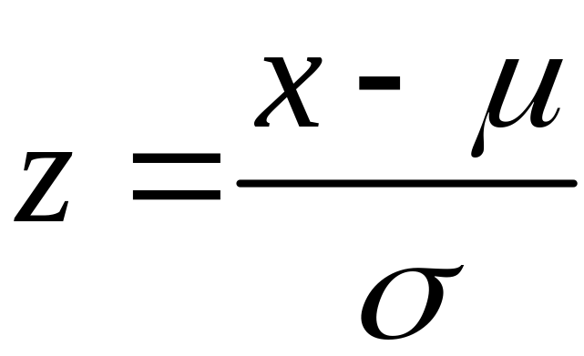
Conversion Formula
Round z scores to 2 decimal places.

Slide 5
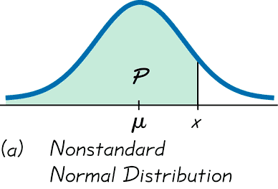
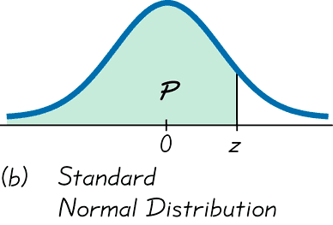
Converting to a Standard
Normal Distribution

Slide 6
Procedure for Finding Areas with a Nonstandard Normal Distribution
1. Sketch a normal curve, label the mean and any specific x values, then shade the region representing the desired probability.
2. For each relevant x value that is a boundary for the shaded region, use Formula 6-2 to convert that value to the equivalent z score.
3. Use computer software or a calculator or Table A-2 to find the area of the shaded region. This area is the desired probability.
Notes:
page 263 of Elementary Statistics, 10th Edition

Slide 7
Example – Tall Clubs International
Tall Clubs International has a requirement that women must be at least 70 inches tall.
Given that women have normally distributed heights with a mean of 63.8 inches and a standard deviation of 2.6 inches, find the percentage of women who satisfy that height requirement.

Slide 8
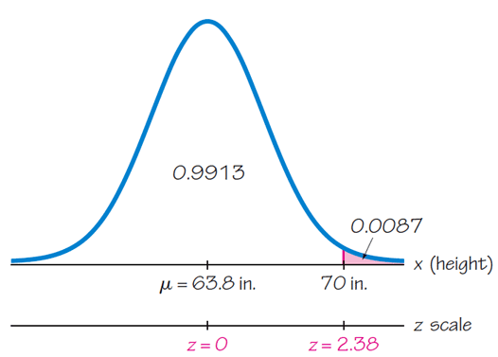
Example – Tall Clubs International
Draw the normal distribution and shade the region.

Slide 9
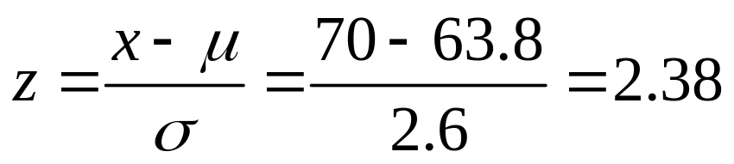
Example – Tall Clubs International
Convert to a z score and use Table A-2 or technology to find the shaded area.
The area to the right of 2.38 is 0.008656, and so about 0.87% of all women meet the requirement.

Slide 10
Finding Values From
Known Areas
1. Don’t confuse z scores and areas. z scores are distances along the horizontal scale, but areas are regions under the normal curve. Table A-2 lists z scores in the left column and across the top row, but areas are found in the body of the table.
2. Choose the correct (right/left) side of the graph.
3. A z score must be negative whenever it is located in the left half of the normal distribution.
4. Areas (or probabilities) are positive or zero values, but they are never negative.

Slide 11

Procedure For Finding Values
From Known Areas or Probabilities
1. Sketch a normal distribution curve, enter the given probability or percentage in the appropriate region of the graph, and identify the x value(s) being sought.
2. If using technology, refer to the instructions at the end of the text, section 6.3. If using Table A-2 to find the z score corresponding to the cumulative left area bounded by x. Refer to the body of Table A-2 to find the closest area, then identify the corresponding z score.
3. Using Formula 6-2, enter the values for μ, σ, and the z score found in step 2, and then solve for x.
(Another form of Formula 6-2)
4. Refer to the sketch of the curve to verify that the solution makes sense in the context of the graph and in the context of the problem.
Notes:
page 263 of Elementary Statistics, 10th Edition

Slide 12
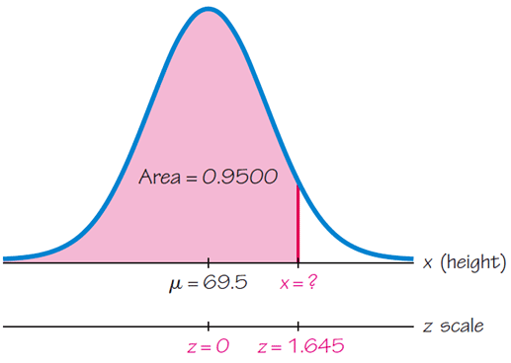
Example – Aircraft Cabins
When designing aircraft cabins, what ceiling height will allow 95% of men to stand without bumping their heads? Men’s heights are normally distributed with a mean of 69.5 inches and a standard deviation of 2.4 inches.
First, draw the normal distribution.

Slide 13
Example – Aircraft Cabins
When designing aircraft cabins, what ceiling height will allow 95% of men to stand without bumping their heads? Men’s heights are normally distributed with a mean of 69.5 inches and a standard deviation of 2.4 inches.
With z = 1.645, μ = 69.5, and σ = 2.4. we can solve for x.

Slide 14
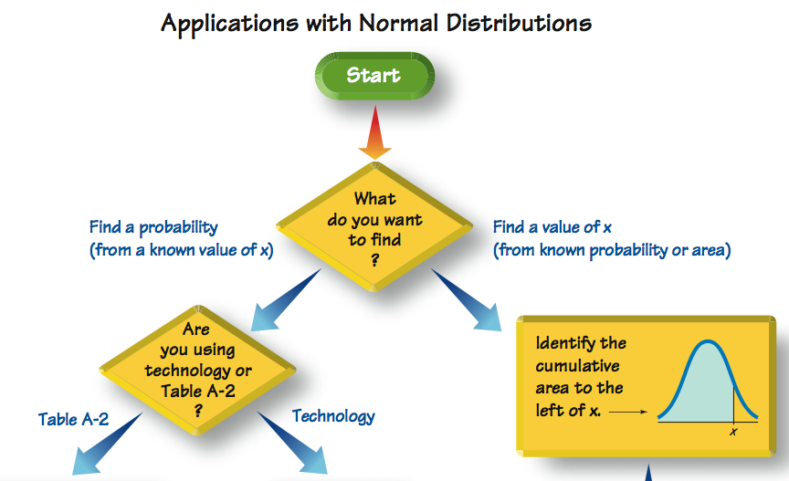

Slide 15

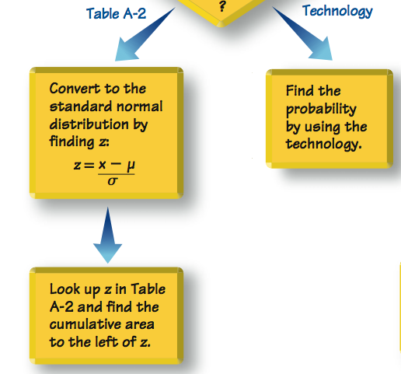

Slide 16

